Slide 2
What We Will Cover
Identify & Measure the Issue
Importance of the Census & Funding
The Perspective of Formerly Incarcerated Individuals
Special Initiatives by Organizations to Increase the Count of Formerly Incarcerated Individuals
Prison Gerrymandering
Resources & Other Programs
Census Updates
Q&A

Slide 3
African-American households are at risk of being undercounted. The African-American population has been historically undercounted in the decennial census, disadvantaging their families, communities, and neighborhoods. In fact:
• The 2010 Census undercounted the African-American population by more than 800,000
• Approximately 7 percent of young African-American children were overlooked by the 2010 Census, roughly twice the rate for young non-Hispanic White children.
• African-American men have been historically undercounted in greater numbers than men of other racial or ethnic groups.
• Today, more than one in three African Americans live in historically undercounted census tracts.

Slide 4
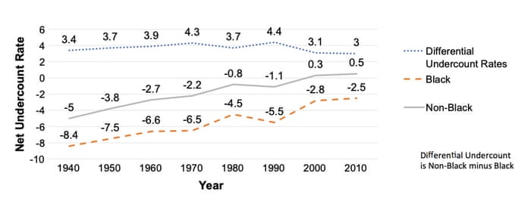
Of this rate, African-American men have been historically undercounted in greater numbers than men of other racial or ethnic groups

Slide 5
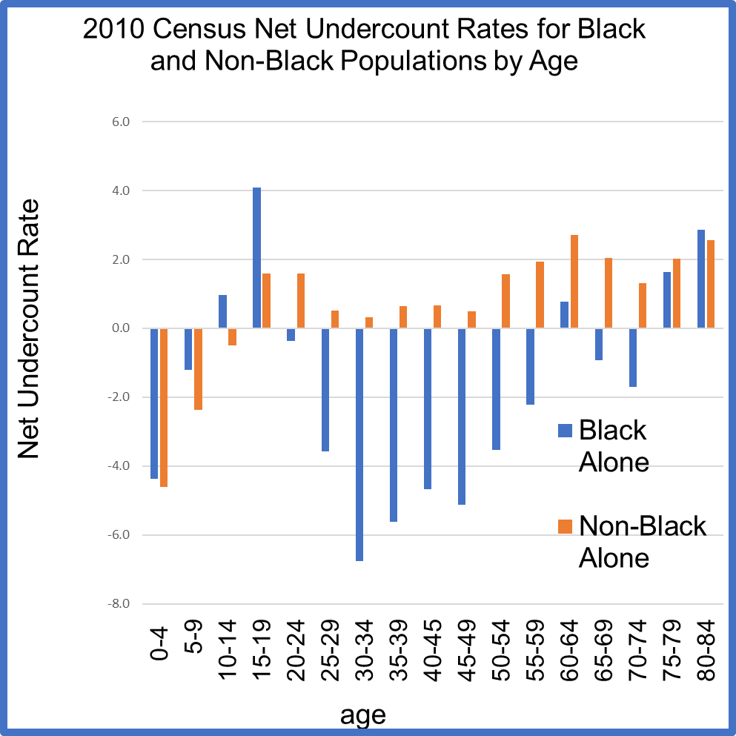
Dr. William O’Hare – Count All Kids
Note: Net undercounts are
shown as a negative numbers

Slide 6
3,734,229 persons (Black Alone or in combination) were missed in the 2010 Census

Slide 7
More than 600,000 are released from prisons into communities every year, more than double the rate of the 1990s. Those who are released from prison tend to have very limited choices when it comes to where to live; most head to disadvantaged and socially marginalized neighborhoods. Black and Hispanic respondents were much more likely to move to severely disadvantaged neighborhoods than whites. And many prisoners [sic] form no real neighborhood attachments at all to these neighborhoods, which contributes to their further social isolation. – “Released Prisoners Struggle to Establish Neighborhood Connections,” Richard Florida August 23, 2018

Slide 8
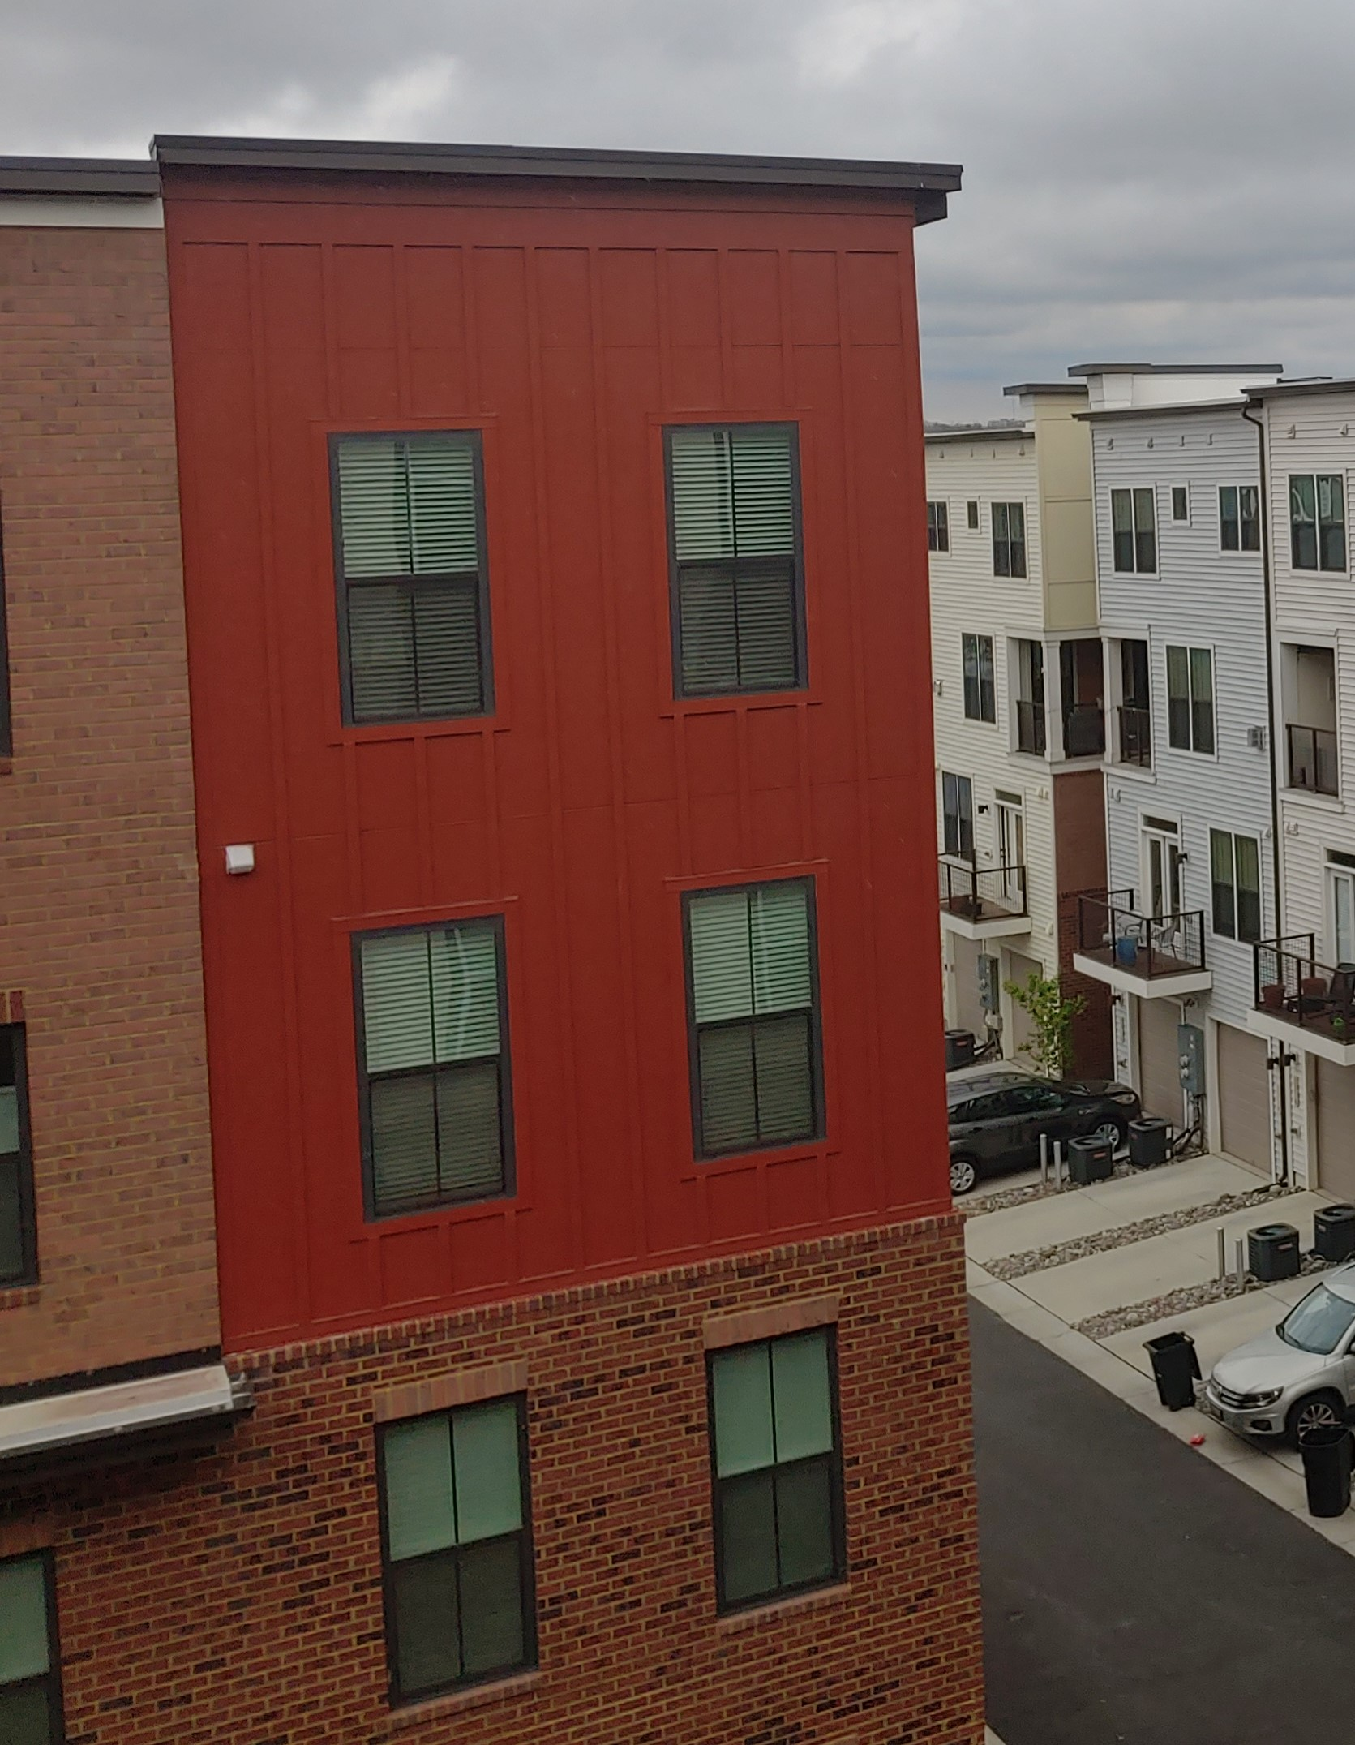
EDUCATION HOUSING HEALTH EMPLOYMENT
Notes:
This Photo by Unknown Author is licensed under CC BY-SA [employment]

Slide 9
Counting Formerly Incarcerated Individuals in the 2020 Census
April 2, 2020
NSOMBI LAMBRIGHT
EXECUTIVE DIRECTOR
SHIRLEY M. MOCK
CHIEF OPERATING OFFICER
Leon Russell,
Chairman – National Board of Directors
Nsombi Lambright,
Executive Director
ONE VILLAGE. ONE VISION. ONE VOICE..

Slide 10
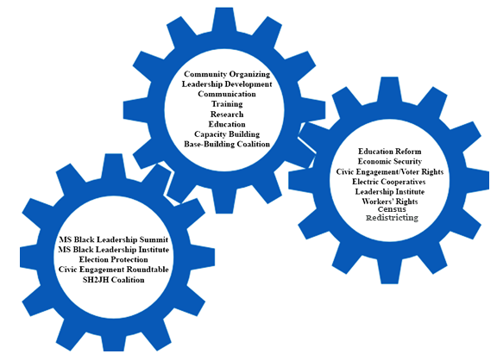
Who We Are
One Voice is a non-profit organization that build community awareness by organizing civic institutions and partnering with community, state and regional coalitions that support and increase the efficacy of local organizations.
We believe that by strengthening local leadership, building community awareness, increasing civic participation and enhancing the capacity of existing organizations, we can impact the formation of public policy to generate structural transformation and it all starts with the Census followed by the Redistricting process.
Program Areas of Work
ONE VILLAGE. ONE VISION. ONE VOICE..

Slide 11
2020 Census
The 2020 Census is a count of every person living in the United States every 10 years, it is mandated by the U.S. Constitution.
The Census determines the number of congressional seats and the drawing of legislative and congressional districts.
Census data is used to determine how billions of federal dollars are distributed to more than 100 programs like Medicaid, Supplemental Nutrition Assistance Program (SNAP), National School Lunch Program, and infrastructure, to name a few.

Slide 12
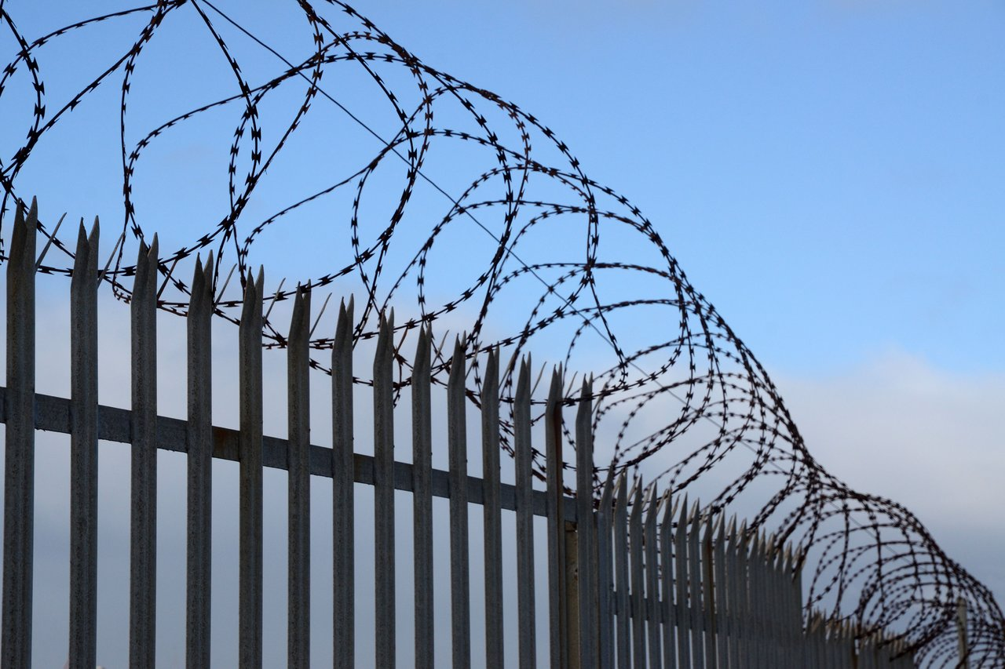
The Numbers
Mississippi has the highest African-American population in the Nation at 37% and the highest African-American incarcerated population in the Nation 66%.
African-American adult males represent 34% of Mississippi adult male population.
In 2017, there were more than 33,000 people on community supervision in Mississippi.
In 2014, the state legislature passed HB 585 which attempted to dismantle the state’s truth in sentencing provision. Truth in sentencing required individuals to serve 85% of their sentence.
https://www.pewtrusts.org/en/research-and-analysis/articles/2018/01/16/national-prison-rate-continues-to-decline-amid-sentencing-re-entry-reforms

Slide 13
The Work
Created a 2020 Census awareness campaign on the importance of the Census that was targeted to the Hard to Count (HTC) population
Hosted Census workshops, community meetings and other activities with community-based organizations
Help formed CCC with community-based organizations, faith leaders and influencers in communities across the State.

Slide 14
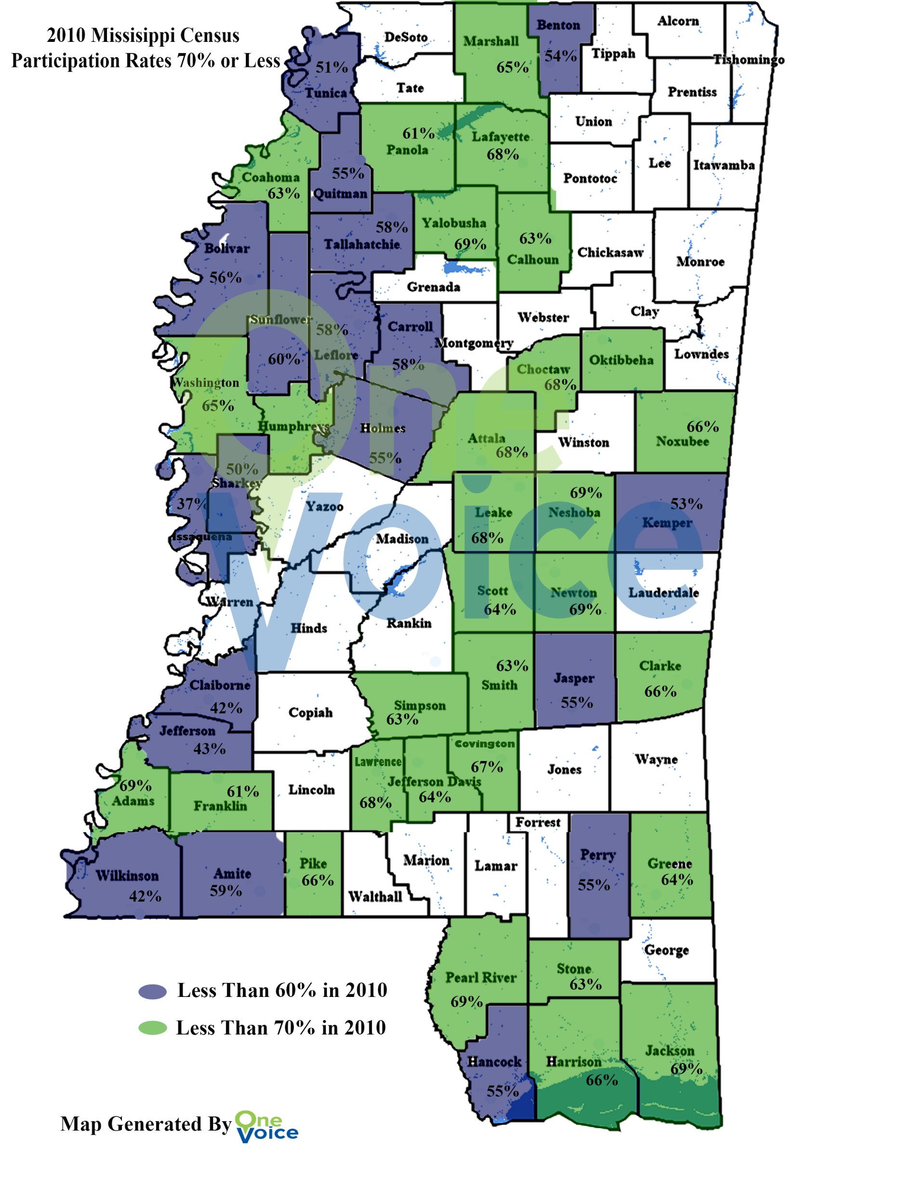
Where to Count
Census HTC MAP
OV Target Map

Slide 15
The Outreach
One Voice partner with the Census Bureau Mississippi Partnership Specialist traveling over thousands of miles across the State educating and engaging communities and mobilizing them to complete their census.
One Voice talked to hundreds of migrant families who had been impacted by the August ICE raids. We traveled to four communities along with a Spanish speaking Census rep to and a trusted community voice to talk to them about the importance of the Census.
Targeted outreach to underserved communities with messages around protecting data and that Census will not impact employment, housing, benefits or criminal record. Connecting with organizations like Reaching, Educating for Community Hope (RECH).
Connecting Census to other issues like felony disenfranchisement; if people with records are able change districts perhaps, they will gain a voice through fair representation that will lead to change in this law.

Slide 16
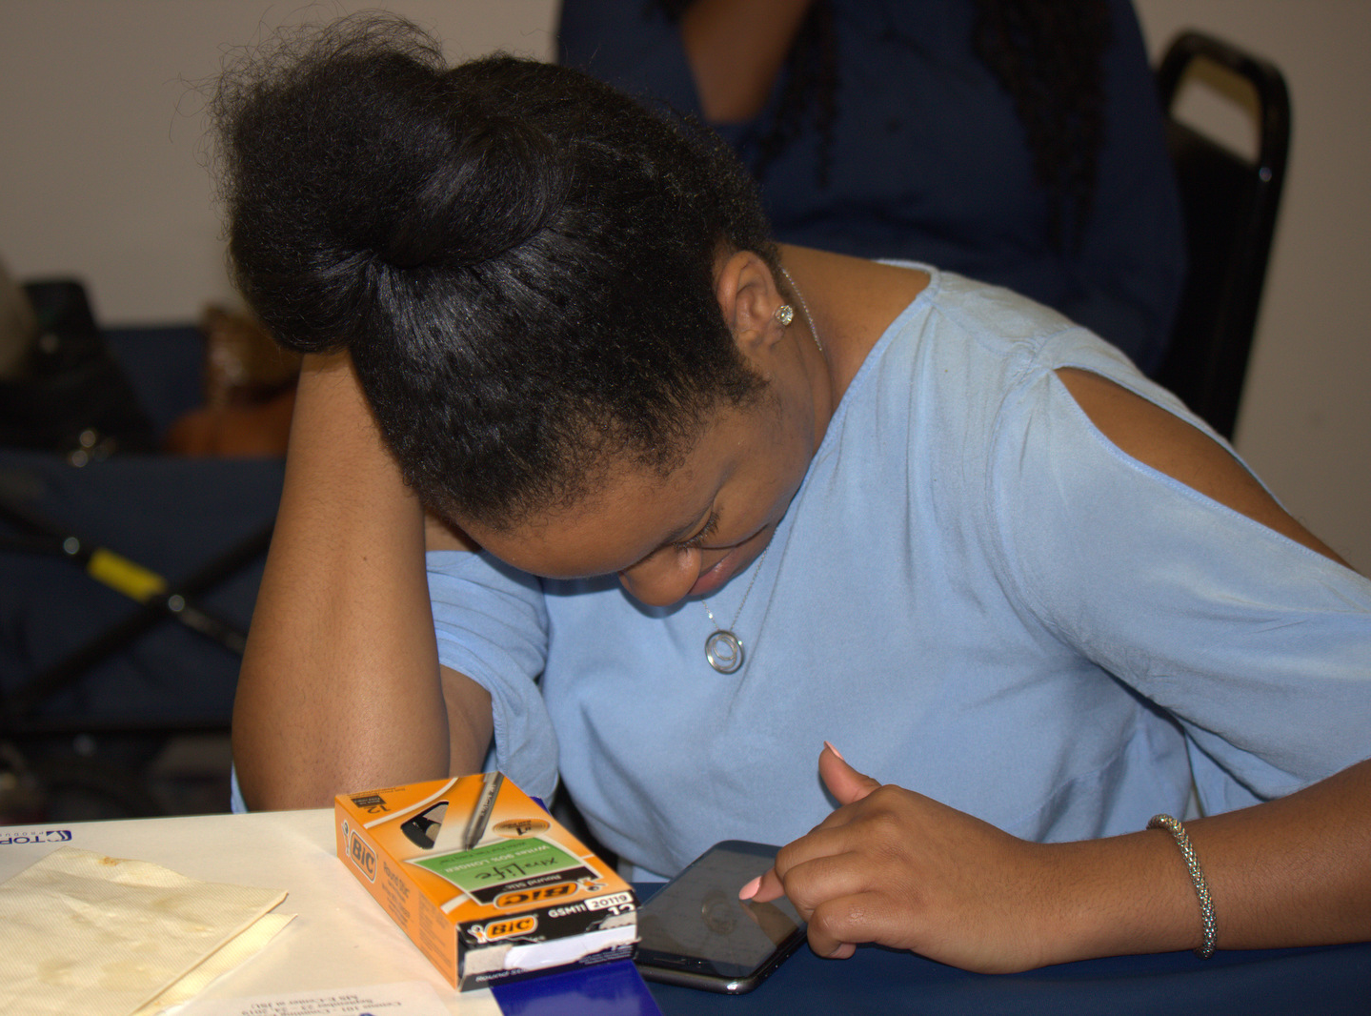
What Works
Through a variety of grassroots organizing tactics such as community meetings, forming CCC, phonebanking, canvassing, and digital engagement we can increase community awareness around 2020 Census and increase Mississippi self response rate in the 2020 Census process.

Slide 17
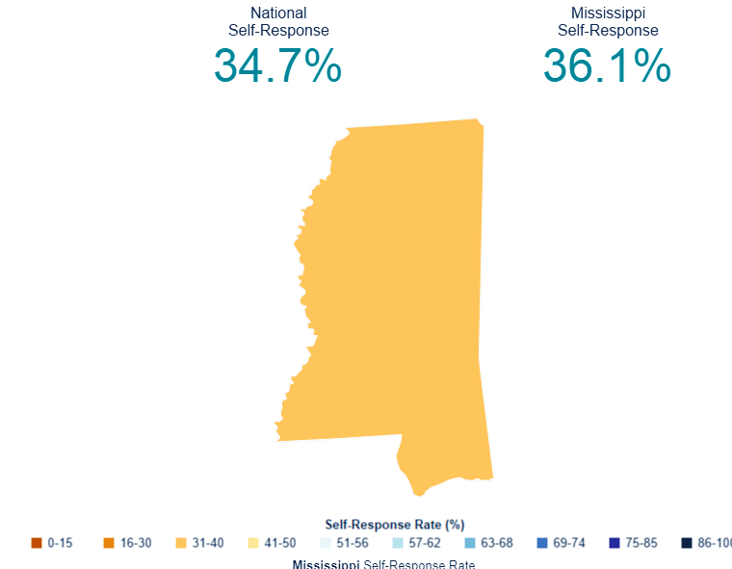
Mississippi Self-Response Rate
(as of 3/30/2020)

Slide 18
CONTACT US
1072 W Lynch Street Suite 7
(601) 960-9594
info@uniteonevoice.org
www.onevoicems.org
ONE VILLAGE. ONE VISION. ONE VOICE..

Slide 20
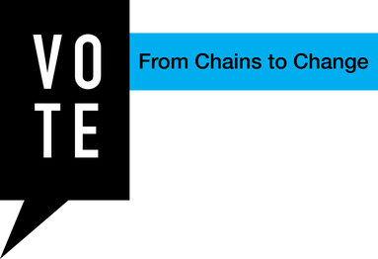
THE TIME TO END MASS INCARCERATION IS NOW
Notes:
vote-nola.org

Slide 21
Counting Formerly Incarcerated Persons in the 2020 Census
Webinar:
Lawyers’ Committee for Civil Rights Under the Law
Jeri Green
2020 Census Senior Advisor
National Urban League (Consultant)
April 2, 2020

Slide 22
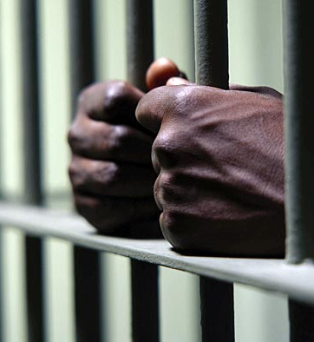
2020 Census Counting Prisoners: A Brief Primer
The Census Bureau counts prison inmates as residents of the prisons where they are serving their sentences instead of counting them as residents of the places they lived before they were incarcerated.
When former prisoners return to their residences, their prison “districts” continue to reap the benefits of the Census count.
Neither communities that house prisons nor communities that lose people to prison are reflected accurately in the data produced under the current counting method.

Slide 23
A Growing and Significant Population: Counting Formerly Incarcerated
Increased prison population= increased rates of release
Currently federal and state prisons release 700,000+ people every year, at a rate of 1,600 daily.
Millions of Americans have lost the right to vote because they were convicted of felonies.
Counting formerly incarcerated is about Money, Power and Respect!
Census participation benefits formerly incarcerated and their communities.

Slide 24
Obstacles to an Accurate Count of Formerly Incarcerated Persons
Housing Insecurity: A report by the Prison Policy Initiative, formerly incarcerated 10x more likely to be homeless than general public.
Privacy Concerns: Use of criminal records to screen potential tenants, prospects for employment, education, public assistance, and even civic participation (volunteering)
Formerly Incarcerated Are Hard to Reach and highly mobile: marginally housed in hotels, motels, or rooming houses but not counted as homeless.
Formerly incarcerated appear to have few formal ties to the tax system or to institutions that generate a filing requirement or an information return—may fear IRS, Child support arrears
Often it is not just the former prisoner or person with felony convictions impacted; the well-being of their families is often threatened—i.e., public/affordable housing

Slide 25
Strategies: Us Counting Us
The Funders Census Initiative 2020 (FCI), has mobilized philanthropic engagement towards a fair and accurate 2020 Census through outreach, education, resource development, and technical assistance.
An accurate count of Formerly Incarcerated populations is an important component of philanthropy’s 2020 Census HTC outreach efforts, including providing grants to organizations representing Formerly Incarcerated populations to help Get Out the Count!
Formerly Incarcerated Convicted People and Families Movement (FICPFM) is one of the organizations engaging the formerly incarcerated national network to ensure they are counted towards the allocation of federal funds and political power in America. FICPFM's organizations will reach thousands of people in California, Georgia, Florida, Louisiana, Michigan, Mississippi, New York, North Carolina, Ohio, Texas, and Wisconsin.
FICPFM awarded 10 organizations $25,000 grants to do critical census outreach to directly impacted people and their families.

Slide 26
Count All of Us or None Our Vision: This Census, let’s make sure #We Count all our formerly-incarcerated comrades and family members and keep our resources –our schools, healthcare, social services and housing in our community! Riverside, CA San Antonio, TX

Slide 27
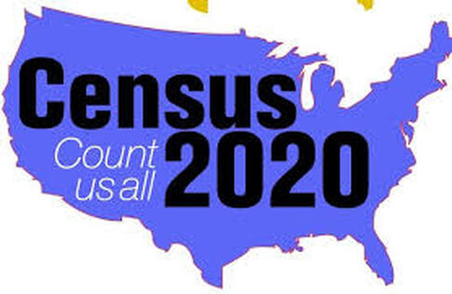
We are part of this country and we need to be represented. Being counted means being heard – it means having our needs met.
The formerly incarcerated exist within different populations that are under-counted and under-served. It is important for us to be counted in the 2020 Census to ensure that our communities have fair access to healthcare and social services funding.
RECH FOUNDATION: JACKSON, MS

Slide 28
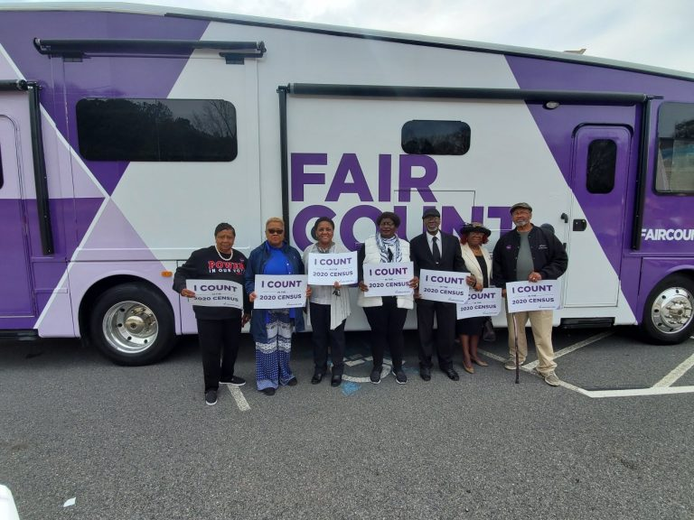
Fair Count, Founded by Stacey Abrams, is dedicated to partnering with Hard to Count (HTC) communities to achieve a fair and accurate count of all people in Georgia to strengthen pathways to greater civic participation
Black men represent one of the most historically undercounted groups in the 2010 Census, with net undercount rates reaching 10% for some age groups.
To ensure that Black men are fairly counted and represented in the 2020 Census, Fair Count has established Black Men Count, a statewide Complete Count Committee that will help ensure a fair and accurate count of Black men across the state of Georgia.

Slide 29
Urban Reentry Jobs Program
Helping people transition from prison to productive careers
The URJP provides formerly incarcerated adults with the necessary skills and training to successfully re-enter the job market with positions that pay a livable wage.

Slide 30
Conclusion
Incarcerated Individuals, their families and communities are deprived of Money, Power, Representation and Respect by being counted as residents of their prison cells away from their communities
Formerly incarcerated men and women want the same thing that everyone else wants for their communities: better schools, affordable housing, jobs and healthcare
Formerly incarcerated individuals are returning to our communities in great numbers; Their Count Matters
Reentering members of society face extraordinary challenges that are obstacles to an accurate count.
Advocacy to change the Census Bureau’s Residence Rules must begin well before the 2030 Census.

Slide 31
Thank you!
Jeri Green
2020 Census Senior Advisor
National Urban League
jerigreen202@gmail.com

Slide 32
PRISON GERRYMANDERING
The Census Act of 1790 established the concept of “usual residence” as the main principle in determining where people should be counted, and this concept has been followed in all subsequent censuses. “Usual residence” has been defined as the place where a person lives and sleeps most of the time. This place is not necessarily the same as the person's voting residence or legal residence.

Slide 33
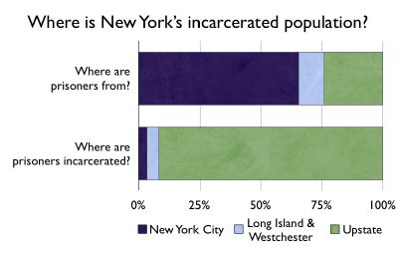
60% of Illinois' prisoners are from Cook County (Chicago), yet 99% of them are counted outside the county.
PRISON POLICY INITIATIVE

Slide 34
Reallocation Statutes | Year Enacted | Year Implemented | Legislative, Congressional, or Both | State Inmates | Federal Inmates
California Cal. Elec. Code § 21003 | 2012 | 2020 | Both | If in-state resident prior to incarceration: counted in last known residence’s district population If out-of-state resident prior to incarceration, or unknown: excluded from all district populations | Excluded from all district populations
Colorado House Bill 20-1010 (to be added to CRS § 2-2-901 and 2-2-902) | 2020 | 2020 | Both | If in-state resident prior to incarceration: counted in last known residence's district population If out-of-state resident prior to incarceration, or unknown: the prisoners are counted for purposes of redistricting in the correctional facility. | Not addressed
Delaware 29 Del. Code tit. 29, § 804A | 2010 | 2020 | Legislative (only 1 congressional district) | If in-state resident prior to incarceration: counted in last known residence’s district population If out-of-state resident prior to incarceration, or unknown: excluded from all district populations | If in-state resident prior to incarceration: counted in last known residence’s district population If out-of-state resident prior to incarceration, or unknown: excluded from all district
Maryland MD State Gov’t Art. § 2-2A-01 (legislative) MD Elec. Law Art. § 8-701 (congressional) | 2010 | 2010 | Both | If in-state resident prior to incarceration: counted in last known residence’s district population If out-of-state resident prior to incarceration, or unknown: excluded from all district populations | If in-state resident prior to incarceration: counted in last known residence’s district population If out-of-state resident prior to incarceration, or unknown: excluded from all district populations
Nevada Ass. Bill No. 450 (to be added to Nev. Rev. Stat. § 360) | 2019 | 2020 | Both | If in-state resident prior to incarceration: counted in last known residence’s district population If out-of-state resident prior to incarceration, or unknown: Not Addressed | Not Addressed
New Jersey S 758 (to be added to N.J.S.A.) | 2020 | 2020 | Legislative | If in-state resident prior to incarceration: counted in last known residence's district population If out-of-state resident prior to incarceration, or unknown: excluded from all district populations | If in-state resident prior to incarceration: counted in last known residence's district population If out-of-state resident prior to incarceration, or unknown: excluded from all district populations
New York N.Y. Legis. Law § 83-m(13) | 2010 | 2010 | Legislative | If in-state resident prior to incarceration: counted in last known residence’s district population If out-of-state resident prior to incarceration, or unknown: excluded from all district populations | Excluded from all district populations
Washington WA S.B. 5287 (to be added to Wash. Rev. Code § 44.05) | 2019 | 2020 | Both | If in-state resident prior to incarceration: counted in last known residence’s district population If out-of-state resident prior to incarceration, or unknown: excluded from all district populations ** Also applies to incarcerated juveniles and involuntarily committed behavioral health patients ** | N
Notes:
Excludes local jurisdictions

Slide 35
RESOURCES

Slide 36
Hard-to-Count Mapping Application
2020 Hard-to-Count Mapping Application
http://www.censushardtocountmaps2020.us/
Mapping Application Tutorial
https://mailchi.mp/da4ad37868ba/census2020-htc-map-updates-feb-2020
Example #1 – Finding areas with very high risk of undercount of young children in a state In this example, someone is trying to find the areas in the state of Georgia with the highest undercount risk for young children. Using the CUNY map, one can produce a map of Georgia with the very high risk of Undercount tracts in large counties highlighted. There are two different ways one can do this with the CUNY mapping application. First, using the “+” and “-“ buttons on the CUNY mapping application, focus in on the geography area you are interested in and center the arrow over the county you are interested in. The tracts in the county will show which census tracts are at very high risk of undercount, which are at high risk of undercount, and which are a low risk of undercount. Also on the CUNY mapping application (https://www.censushardtocountmaps2020.us/) in the upper left-hand corner there is a box for “ST./CO”. Click on that box, hover the arrow over the state of Georgia and click the “Zoom in” button in the upper lefthand corner of the screen. Using the “Share Map” button” in the upper lefthand corner of the page, one can then download the URL that will take people to this map of Georgia.

Slide 37
https://bit.ly/2WUTeAy

Slide 38
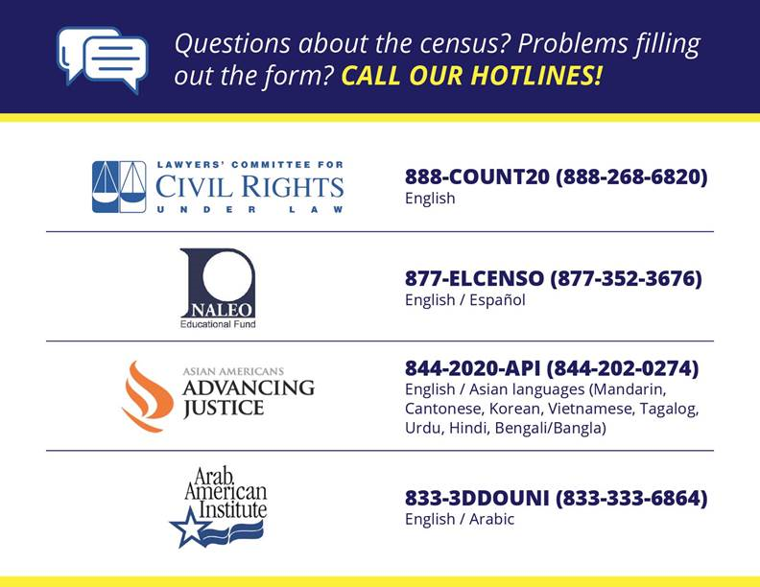

Slide 39
RSVP here.

Slide 40
Special thanks to
CENTER FOR URBAN RESEARCH

